Slide 1
Termination using common Lyapunov function
Presented By:
ANURAG PRASAD
21BSA10075
B.Tech(CSE) Year-III
Presented To:
Dr Ankur Jain
Assistant Professor,
School of Computing Science and Engineering (SCSE) VIT Bhopal University,
Bhopal-Indore Highway, Kothrikalan,
Sehore, Madhya Pradesh - 466114
Email: ankurjainjob@gmail.com, ankur.jain@vitbhopal.ac.in
Mobile: 7415259169

Slide 2
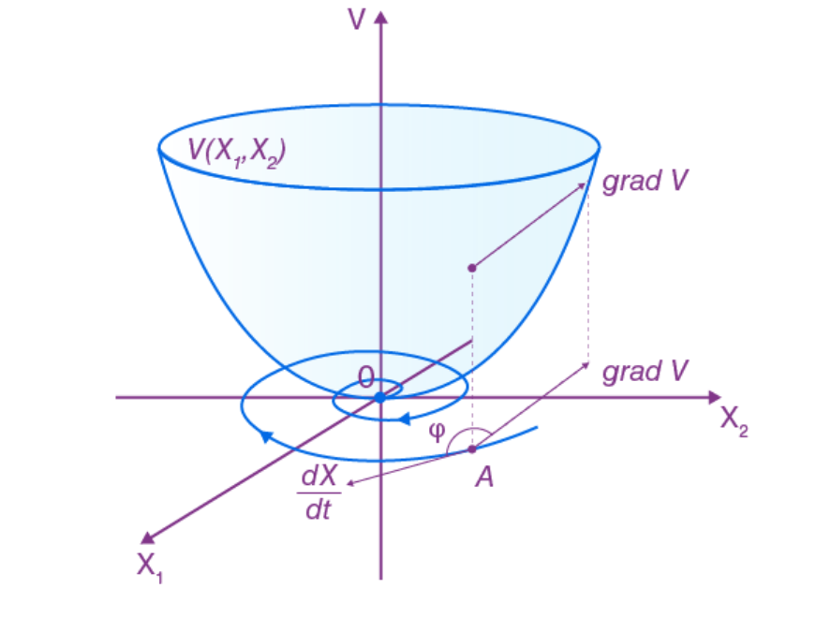
Lyapunov function
A Lyapunov function helps us figure out if something will eventually stop or if it will go on forever by looking at the path it's following, like a car on a bumpy track.
It's a tool that helps scientists and engineers understand how things behave in different situations.
A Lyapunov function with one stable equilibrium

Slide 3
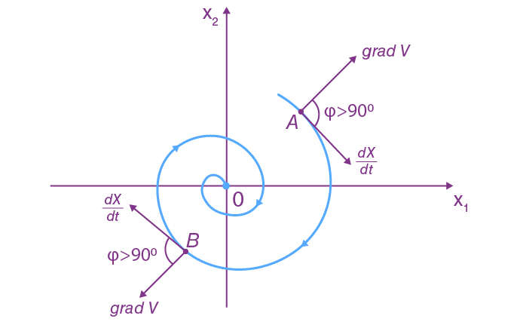
Lyapunov function
Suppose V(X) be a continuously differentiable function in the origin’s neighbourhood U. If the following requirements are satisfied, the function V(X) is known as the Lyapunov function for an autonomous system X’ = f(x).
V(X) >0 for all X ∈ U\ {0}
(dV/dt) ≤ 0 for all X ∈ U
V(0) = 0

Slide 4

Aleksandr Lyapunov
Aleksandr Mikhailovich Lyapunov (1857–1918) was a Russian mathematician renowned for his pioneering work in stability theory and dynamical systems.
Lyapunov's groundbreaking contributions include the development of Lyapunov functions, mathematical tools used to analyze the stability of dynamic systems.
His work significantly impacted control theory and engineering, providing a framework to assess whether systems would remain stable or evolve unpredictably.
His contributions in stability analysis remain integral to the study of complex systems across various disciplines.
Aleksandr Lyapunov in 1908

Slide 5
"What does 'termination' mean in the context of a Lyapunov function?"
In the context of a Lyapunov function, "termination" refers to the behavior of a system reaching a stable and unchanging state, typically at an equilibrium point, as indicated by the Lyapunov function and its derivatives.
A Lyapunov function is a mathematical tool used to assess the stability of an equilibrium point in a dynamical system. It helps determine whether, over time, the system's trajectories will converge to and remain within a certain vicinity of the equilibrium point, indicating stability.
It does not refer to the termination of the Lyapunov function itself.

Slide 6
" How to Achieve this Equilibrium/ Stability?”
If a derivative dV/dt along a phase trajectory is always negative, the trajectory will tend to the origin, indicating that the system is stable. Whenever the derivative dV/dt is positive, the system is unstable because the trajectory goes away from the origin.
Stability Theorem in the Lyapunov Sense
If a Lyapunov function V(X) exists in the neighbourhood U of an autonomous system’s zero solution X = 0, the system’s equilibrium point X = 0 is Lyapunov stable.

Slide 7
Reference/Resources
https://www.researchgate.net/figure/Left-a-Lyapunov-function-with-one-stable-equilibrium-Right-a-Lyapunov-function-with_fig1_347796752
https://en.wikipedia.org/wiki/Aleksandr_Lyapunov
https://en.wikipedia.org/wiki/Lyapunov_function
https://en.wikipedia.org/wiki/Lyapunov_stability
https://web.stanford.edu/class/ee363/lectures/lyap.pdf
https://www.youtube.com/watch?v=uXAx_641FPM
https://www.sciencedirect.com/topics/engineering/lyapunov-function

Slide 8
THANK YOU!

